Slide 1
Surviving Spouse Liaison Report
North Carolina Council of Chapters
3rd Quarterly Meeting
August 13, 2016

Slide 2
Resource Materials
Link to National MOAA’s website at http://www.moaa.org/
In the Header bar, choose “Family” and “Surviving Spouses”
Subcategories include:
Overview
Advisory Committee
Corner
Join Now
And others

Slide 3
Survivor Issues
Under the “Surviving Spouses of MOAA,” open the “Jump to” tab and select “Resources”
Under “Resources” choose “Publications”
Open the “Jump to” tab again and choose “Survivor Issues”
There are several publications that you can receive at no charge as an MOAA member
Help Your Survivors Now” A Guide to Planning Ahead
Survivor’s Checklist”: First Steps for Moving On
Your Guide to Military Burials
Turning the Corner
Survivor’s Planning Guide – for you and your spouse’s use NOW!

Slide 4

Help Your Survivors Now: A Guide to Planning Ahead
This guide can help you prepare, make decisions, and ease the financial, medical, and property transition for your family after you're gone

Slide 5

Survivor’s Checklist: First Steps for Moving On
Essential checklist to keep on hand to refer to when dealing with a death in the family.

Slide 6
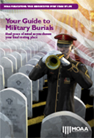
Your Guide to Military Burials
A resource for planning and decision-making regarding military burials and rights and to create a plan for the future.

Slide 7

Turning the Corner
This publication is meant to help you recognize and understand some of the aspects of the grieving process and help guide you through this difficult time.

Slide 8
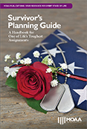
Survivor’s Planning Guide
To keep track of what arrangements need to be made, who needs to be contacted, and notes on important phone calls, this guide was designed by surviving spouses to help you do just that.

Slide 9
Use of the Planning Guide is as simple as “filling in the blanks”
ENLIST FAMILY AND FRIENDS TO CONTACT OTHERS (List names and phone numbers.
NAME: _____________________________________________________________
PHONE NUMBER: ____________________________________________________
NAME: _____________________________________________________________
PHONE NUMBER: ____________________________________________________
NAME: _____________________________________________________________
PHONE NUMBER: ____________________________________________________
NAME: _____________________________________________________________
PHONE NUMBER: ____________________________________________________

Slide 10
Other important sections
Make burial or cremation arrangements
Cemetery
Memorial Service
Use a local VSO
Stop retired pay and apply for applicable benefits
Notify the Social Security Administration
Contact the VA
Manage Investments
Contact the TSP Administrator
Notify Credit Card Companies
Obtain a new Surviving Souse ID Card
Notify Life Insurance Companies

Slide 11
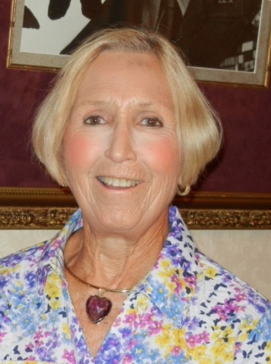
Carol Ivey NCCOC Surviving Spouse Liaison
Questions, comments or assistance…
Contact information for Carol Ivey @
(910) 868-3213
cgivey191@aol.com

